Slide 1
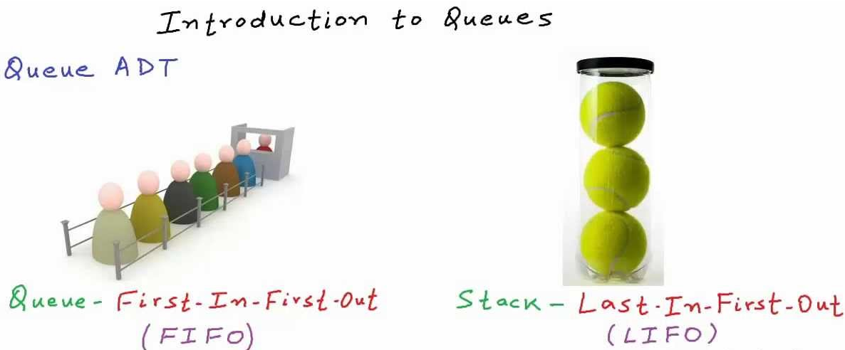
Queues

Slide 2
Introduction
A queue works like a line at the movies: the first person to join the rear of the line is the first person to reach the front of the line and buy a ticket. The last person to line up is the last person to buy a ticket (or—if the show is sold out—to fail to buy a ticket).
There are various queues quietly doing their job in your computer’s (or the network’s) operating system. There’s a printer queue where print jobs wait for the printer to be available. A queue also stores keystroke data as you type at the keyboard.

Slide 3
This way, if you’re using a word processor but the computer is briefly doing something else when you hit a key, the keystroke won’t be lost; it waits in the queue until the word processor has time to read it. Using a queue

Slide 4
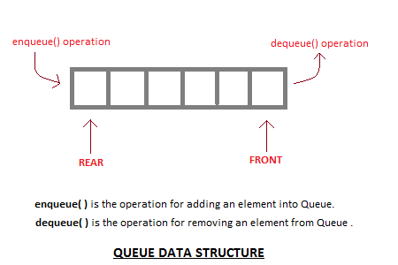
What is a Queue?
A queue is a linear list of elements in which deletion of an element can take place only at one end called the front and insertion can take place on the other end which is termed as rear. The term front and rear are used frequently while describing queues in a linked list. In this chapter you will deal with queue as arrays.

Slide 5
In the concept of queue, the first element to be inserted in the queue will be the first element to be deleted or removed from the list. So Queue is said to follow the FIFO (First In First Out) structure.
A real life scenario in the form of example for queue will be the queue of people waiting to accomplish a particular task where the first person in the queue is the first person to be served first.

Slide 6
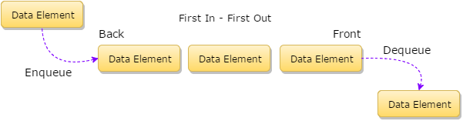

Slide 7
Queue as an ADT (Abstract Data Type)
The meaning of an abstract data type clearly says that for a data structure to be abstract, it should have the below mentioned characteristics:
First, there should be a particular way in which components are related to each other
Second, a statement for the operation that can be performed on elements of abstract data type must have to be specified

Slide 8
Queue as an ADT (Abstract Data Type)
Thus for defining a Queue as an abstract data type, these are the following criteria:
Initialize a queue to be empty
Check whether a queue is empty or not
Check whether a queue is full or not
Insert a new element after the last element in a queue, if the queue is not full
Retrieve the first element of the queue, if it is not empty
Delete the first element in a queue, if it is not empty

Slide 9
The queue abstract data type is defined by the following structure and operations. A queue is structured, as described above, as an ordered collection of items which are added at one end, called the “rear,” and removed from the other end, called the “front.” Queues maintain a FIFO ordering pQueue() creates a new queue that is empty. It needs no parameters and returns an empty queue.
enqueue(item) adds a new item to the rear of the queue. It needs the item and returns nothing.
dequeue() removes the front item from the queue. It needs no parameters and returns the item. The queue is modified.
isEmpty() tests to see whether the queue is empty. It needs no parameters and returns a boolean value.
size() returns the number of items in the queue. It needs no parameters and returns an integer. The queue operations are given below.

Slide 10
Queue operations
Queue Operation | Queue Contents | Return Value
q.isEmpty() | [] | True
q.enqueue(4) | [4]
q.enqueue('dog') | ['dog',4]
q.enqueue(True) | [True,'dog',4]
q.size() | [True,'dog',4] | 3
q.isEmpty() | [True,'dog',4] | False
q.enqueue(8.4) | [8.4,True,'dog',4]
q.dequeue() | [8.4,True,'dog'] | 4
q.dequeue() | [8.4,True] | 'dog'
q.size() | [8.4,True] | 2

Slide 11
The Queue Operations
A queue is like a line of people waiting for a bank teller. The queue has a front and a rear.
$ $
Front
Rear
Notes:
When you think of a computer science queue, you can imagine a line of people waiting for a teller in a bank. The line has a front (the next person to be served) and a rear (the last person to arrive.

Slide 12
The Queue Operations
New people must enter the queue at the rear. The C++ queue class calls this a push, although it is usually called an enqueue operation.
$ $
Front
Rear
Notes:
Don’t ask me why the C++ STL used the name push. It only confuses matters with a stack. In any case, when a new item enters a queue, it does so at the rear.

Slide 13
The Queue Operations
When an item is taken from the queue, it always comes from the front. The C++ queue calls this a pop, although it is usually called a dequeue operation.
$ $
Front
Rear
Notes:
When an item is removed from a queue, the removal occurs at the front.

Slide 14
Operations performed on queues:
1. Insertion: inserting a new element into the queue.
2. Deletion : deleting a new element from the queue.
3. Display : visit each node at least once.
Queue is full- there is no room to insert a new element.
Queue is empty- there is no element to delete from queue.

Slide 15
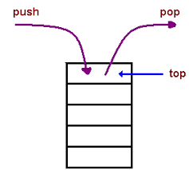
INSERTION
Queues maintain two data pointers, front and rear. Therefore, its operations are comparatively difficult to implement than that of stacks.
The following steps should be taken to enqueue (insert) data into a queue −
Step 1 − Check if the queue is full.
Step 2 − If the queue is full, produce overflow error and exit.
Step 3 − If the queue is not full, increment rear pointer to point the next empty space.
Step 4 − Add data element to the queue location, where the rear is pointing.
Step 5 − return success.

Slide 16
ALGORITHM FOR ENQUEUE OPERATION
procedure enqueue(data)
if queue is full
return overflow
endif
rear ← rear + 1
queue[rear] ← data
return true
end procedure
EXAMPLE
int enqueue(int data)
if(isfull())
return 0;
rear = rear + 1;
queue[rear] = data;
return 1;
end procedure

Slide 17
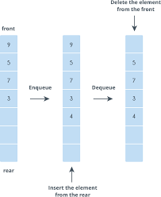
Deletions
Accessing data from the queue is a process of two tasks − access the data where front is pointing and remove the data after access. The following steps are taken to perform dequeue operation −
Step 1 − Check if the queue is empty.
Step 2 − If the queue is empty, produce underflow error and exit.
Step 3 − If the queue is not empty, access the data where front is pointing.
Step 4 − Increment front pointer to point to the next available data element.
Step 5 − Return success.

Slide 18
ALGORITHM FOR DEQUEUE OPERATION
procedure dequeue
if queue is empty
return underflow
end if
data = queue[front]
front ← front + 1
return true
end procedure
EXAMPLE
int dequeue() {
if(isempty())
return 0;
int data = queue[front];
front = front + 1;
return data;
}

Slide 19
BASIC OPERATIONS
Queue operations may involve initializing or defining the queue, utilizing it, and then completely erasing it from the memory. Here we shall try to understand the basic operations associated with queues −
enqueue() − add (store) an item to the queue.
dequeue() − remove (access) an item from the queue.

Slide 20
Few more functions are required to make the above-mentioned queue operation efficient. These are −
peek() − Gets the element at the front of the queue without removing it.
isfull() − Checks if the queue is full.
isempty() − Checks if the queue is empty.

Slide 21
In queue, we always dequeue (or access) data, pointed by front pointer and while enqueing (or storing) data in the queue we take help of rear pointer.
Let's first learn about supportive functions of a queue −
peek()
This function helps to see the data at the front of the queue. The algorithm of peek() function is as follows
Algorithm
begin procedure peek
return queue[front]
end procedure
Example
int peek() {
return queue[front];
}

Slide 22
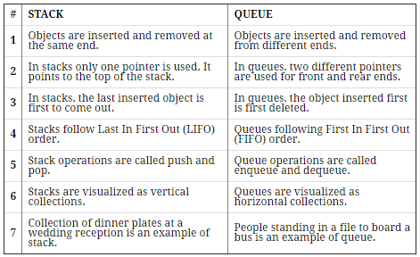

Slide 23
Representation of Queue as an Array
void insert(int x)
{
if (rear > 4) {
cout << "queue over flow";
front = rear = -1;
return;
}
queue1[++rear] = x;
cout << "inserted " << x;
}
void delet()
{
if (front == rear) {
cout << "queue under flow";
return;
}
cout << "deleted " << queue1[++front];
}
#include <iostream>
#include<stdlib.h>
using namespace std;
class queuearr {
int queue1[5];
int rear, front;
public:
queuearr()
{
rear = -1;
front = -1;
}

Slide 24
void display()
{
if (rear == front) {
cout << " queue empty";
return;
}
for (int i = front + 1; i <= rear; i++)
cout << queue1[i] << " ";
}
};
int main()
{
int ch;
queuearr qu;
while (1) {
cout << "\n1.insert 2.delet 3.display 4.exit\nEnter ur choice: ";
cin >> ch;
switch (ch) {
case 1:
cout << "enter the element: "; cin >> ch;
qu.insert(ch);
break;

Slide 25
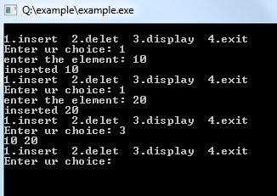
case 2:
qu.delet();
break;
case 3:
qu.display();
break;
case 4:
exit(0);
}
}
}

Slide 26
Array Implementation
A queue can be implemented with an array, as shown here. For example, this queue contains the integers 4 (at the front), 8 and 6 (at the rear).
[ 0 ]
[1]
[ 2 ]
[ 3 ]
[ 4 ]
[ 5 ]
. . .
4
8
6
An array of integers to implement a queue of integers
We don't care what's in
this part of the array.
Notes:
Just like our stack implementation in the previous chapter, one way to implement a queue is to store the elements in an array.

Slide 27
Array Implementation
The easiest implementation also keeps track of the number of items in the queue and the index of the first element (at the front of the queue), the last element (at the rear).
3
size
0
first
2
last
[ 0 ]
[1]
[ 2 ]
[ 3 ]
[ 4 ]
[ 5 ]
. . .
4
8
6
Notes:
The easiest implementation also keeps track of three numbers. The size could be as small as zero or as large as the number of items in the array. The index of the front element is stored in the first member variable. The front item in the queue is at that index of the array. The next item is after the first one and so on until the rear of the queue that occurs at the index stored in a member variable called last.

Slide 28
A Dequeue Operation
When an element leaves the queue, size is decremented, and first changes, too.
2
size
1
first
2
last
[ 0 ]
[1]
[ 2 ]
[ 3 ]
[ 4 ]
[ 5 ]
. . .
4
8
6
Notes:
This shows how the member variables change when an item leaves the queue.

Slide 29
An Enqueue Operation
When an element enters the queue, size is incremented, and last changes, too.
3
size
1
first
3
last
[ 0 ]
[1]
[ 2 ]
[ 3 ]
[ 4 ]
[ 5 ]
. . .
8
6
2
Notes:
And this shows how the member variables change when a new item enters the queue. For a fixed size array, a new item may enter only if the current size of the queue is less than the size of the array. For a dynamic array, we could increase the size of the array when the queue grows beyond the current array size.

Slide 30
At the End of the Array
There is special behavior at the end of the array. For example, suppose we want to add a new element to this queue, where the last index is [5]:
3
size
3
first
5
last
[ 0 ]
[1]
[ 2 ]
[ 3 ]
[ 4 ]
[ 5 ]
2
6
1
Notes:
An array implementation of a queue must have special behavior when the rear of the queue reaches the end of the array. In this example, suppose we want to add the number 4 to the queue. We can do so…

Slide 31
At the End of the Array
The new element goes at the front of the array (if that spot isn’t already used):
4
size
3
first
0
last
[ 0 ]
[1]
[ 2 ]
[ 3 ]
[ 4 ]
[ 5 ]
4
2
6
1
Notes:
…by putting it at location 0 (if that location is not already used).

Slide 32
Array Implementation
Easy to implement
But it has a limited capacity with a fixed array
Or you must use a dynamic array for an unbounded capacity
Special behavior is needed when the rear reaches the end of the array.
3
size
0
first
2
last
[ 0 ]
[1]
[ 2 ]
[ 3 ]
[ 4 ]
[ 5 ]
. . .
4
8
6
Notes:
Here are some of the key aspects of an array implementation of a queue.

Slide 33
Queue Data Structure using Stack
A Queue is defined by its property of FIFO, which means First in First Out, i.e the element which is added first is taken out first. Hence we can implement a Queue using Stack for storage instead of array.
For performing enqueue we require only one stack as we can directly push data into stack, but to perform dequeue we will require two Stacks, because we need to follow queue's FIFO property and if we directly pop any data element out of Stack, it will follow LIFO approach(Last in First Out).

Slide 34
Implementation of Queue using Stacks
In all we will require two Stacks, we will call them InStack and OutStack.
class Queue {
public:
Stack S1, S2;
//defining methods
void enqueue(int x);
int dequeue();
}
We know that, Stack is a data structure, in which data can be added using push() method and data can be deleted using pop() method.

Slide 35
Adding Data to Queue
As our Queue has Stack for data storage in place of arrays, hence we will be adding data to Stack, which can be done using the push() method, hence :
void Queue :: enqueue(int x)
{
S1.push(x);
}

Slide 36
Removing Data from Queue
When we say remove data from Queue, it always means taking out the First element first and so on, as we have to follow the FIFO approach.
But if we simply perform S1.pop() in our dequeue method, then it will remove the Last element first. So what to do now?

Slide 37
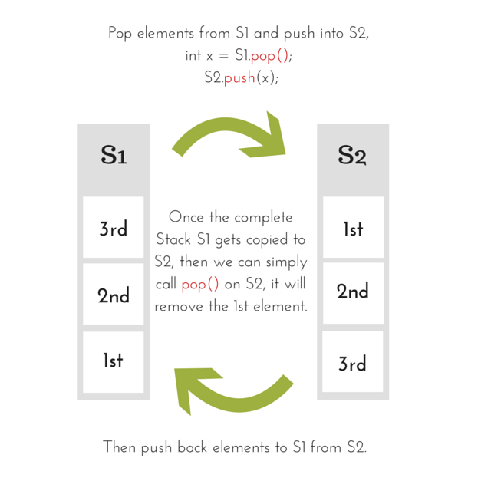

Slide 38
int Queue :: dequeue() {
while(S1.isEmpty()) {
x = S1.pop();
S2.push();
}
//removing the element
x = S2.pop();
while(!S2.isEmpty()) {
x = S2.pop();
S1.push(x);
}
return x;
}

Slide 39
DIFFERENT TYPES OF QUEUES
Queue can be of four types:
1. Simple Queue
2. Circular Queue
3. Priority Queue
4. Dequeue (Double Ended queue)

Slide 40

(I) Simple Queue: In Simple queue Insertion occurs at the rear of the list, and deletion occurs at the front of the list.

Slide 41

(II) Circular Queue : A circular queue is a queue in which all nodes are treated as circular such that the first node follows the last node.

Slide 42
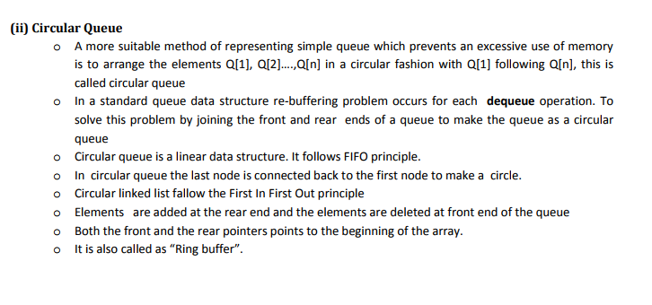

Slide 43
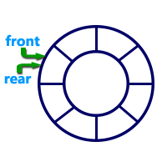
What is Circular Queue?
A Circular Queue can be defined as follows...
Circular Queue is a linear data structure in which the operations are performed based on FIFO (First In First Out) principle and the last position is connected back to the first position to make a circle.
Graphical representation of a circular queue is as follows...

Slide 44
Implementation of Circular Queue
To implement a circular queue data structure using array, we first perform the following steps before we implement actual operations.
Step 1: Include all the header files which are used in the program and define a constant 'SIZE' with specific value.
Step 2: Declare all user defined functions used in circular queue implementation.
Step 3: Create a one dimensional array with above defined SIZE (int cQueue[SIZE])
Step 4: Define two integer variables 'front' and 'rear' and initialize both with '-1'. (int front = -1, rear = -1)
Step 5: Implement main method by displaying menu of operations list and make suitable function calls to perform operation selected by the user on circular queue.

Slide 45
ENQUEUE(VALUE) - INSERTING VALUE INTO THE CIRCULAR QUEUE
In a circular queue, enQueue() is a function which is used to insert an element into the circular queue. In a circular queue, the new element is always inserted at rear position. The enQueue() function takes one integer value as parameter and inserts that value into the circular queue. We can use the following steps to insert an element into the circular queue...
Step 1: Check whether queue is FULL. ((rear == SIZE-1 && front == 0) || (front == rear+1))
Step 2: If it is FULL, then display "Queue is FULL!!! Insertion is not possible!!!" and terminate the function.
Step 3: If it is NOT FULL, then check rear == SIZE - 1 && front != 0 if it is TRUE, then set rear = -1.
Step 4: Increment rear value by one (rear++), set queue[rear] = value and check 'front == -1' if it is TRUE, then set front = 0.

Slide 46
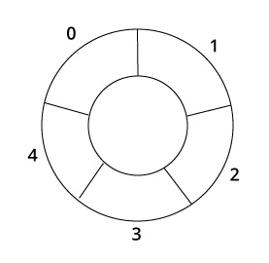
How Circular Queue Works
Circular Queue works by the process of circular increment i.e. when we try to increment any variable and we reach the end of queue, we start from the beginning of queue by modulo division with the queue size.
i.e.
if REAR + 1 == 5 (overflow!), REAR = (REAR + 1)%5 = 0 (start of queue)

Slide 47
Queue operations work as follows:
Two pointers called FRONT and REAR are used to keep track of the first and last elements in the queue.
When initializing the queue, we set the value of FRONT and REAR to -1.
On enqueing an element, we circularly increase the value of REAR index and place the new element in the position pointed to by REAR.
On dequeueing an element, we return the value pointed to by FRONT and circularly increase the FRONT index.
Before enqueing, we check if queue is already full.
Before dequeuing, we check if queue is already empty.
When enqueing the first element, we set the value of FRONT to 0.
When dequeing the last element, we reset the values of FRONT and REAR to -1.

Slide 48
However, the check for full queue has a new additional case:
Case 1: FRONT = 0 && REAR == SIZE - 1
Case 2: FRONT = REAR + 1

Slide 49
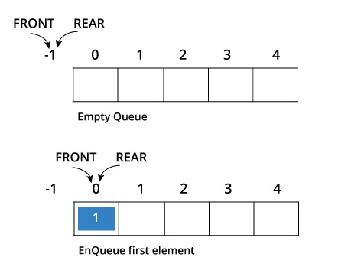
The second case happens when REAR starts from 0 due to circular increment and when its value is just 1 less than FRONT, the queue is full.

Slide 50
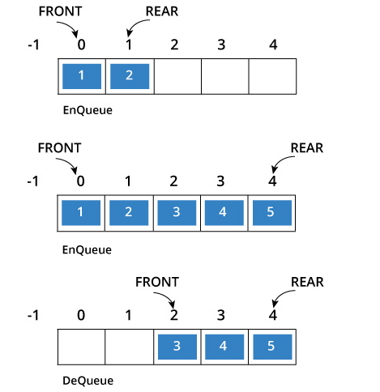
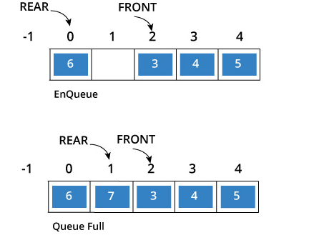

Slide 51
Circular queue
In a circular queue, all nodes are treated as circular. Last node is connected back to the first node.
Circular queue is also called as Ring Buffer.
It is an abstract data type.
Circular queue contains a collection of data which allows insertion of data at the end of the queue and deletion of data at the beginning of the queue.

Slide 52
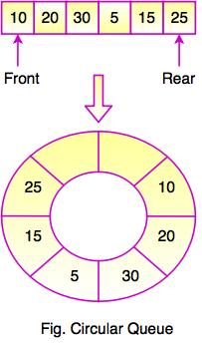


Slide 53
#include <iostream>
#define SIZE 5 /* Size of Circular Queue */
using namespace std;
class Queue {
private:
int items[SIZE], front, rear;
public:
Queue(){
front = -1;
rear = -1;
}
bool isFull(){
if(front == 0 && rear == SIZE - 1){
return true;
}
if(front == rear + 1) {
return true;
}
return false;
}
bool isEmpty(){
if(front == -1) return true;
else return false;
}

Slide 54
void enQueue(int element){
if(isFull()){
cout << "Queue is full";
} else {
if(front == -1) front = 0;
rear = (rear + 1) % SIZE;
items[rear] = element;
cout << endl << "Inserted " << element << endl;
}
}
int deQueue(){
int element;
if(isEmpty()){
cout << "Queue is empty" << endl;
return(-1);
} else {
element = items[front];
if(front == rear){
front = -1;
rear = -1;
} /* Q has only one element, so we reset the queue after deleting it. */
else {
front=(front+1) % SIZE;
}
return(element);
}

Slide 55
int main()
{
Queue q;
// Fails because front = -1
q.deQueue();
q.enQueue(1);
q.enQueue(2);
q.enQueue(3);
q.enQueue(4);
q.enQueue(5);
// Fails to enqueue because front == 0 && rear == SIZE - 1
q.enQueue(6);
void display()
{
/* Function to display status of Circular Queue */
int i;
if(isEmpty()) {
cout << endl << "Empty Queue" << endl;
}
else
{
cout << "Front -> " << front;
cout << endl << "Items -> ";
for(i=front; i!=rear;i=(i+1)%SIZE)
cout << items[i];
cout << items[i];
cout << endl << "Rear -> " << rear;
}
}
};

Slide 56
q.display();
int elem = q.deQueue();
if( elem != -1)
cout << endl << "Deleted Element is " << elem;
q.display();
q.enQueue(7);
q.display();
// Fails to enqueue because front == rear + 1
q.enQueue(8);
return 0;
}
Queue is full
Front -> 0
Items -> 12345
Rear -> 4
Deleted Element is 1
Front -> 1
Items -> 2345
Rear -> 4
Inserted 7
Front -> 1
Items -> 23457
Rear -> 0
Queue is full
Output::
Queue is empty
Inserted 1
Inserted 2
Inserted 3
Inserted 4
Inserted 5

Slide 57
Circular Queue can be created in three ways they are
Using single linked list
Using double linked list
Using arrays

Slide 58

Using single linked list
It is an extension for the basic single linked list. In circular linked list Instead of storing a Null value in the last node of a single linked list, store the address of the 1st node (root) forms a circular linked list. Using circular linked list it is possible to directly traverse to the first node after reaching the last node.

Slide 59

Using double linked list
In double linked list the right side pointer points to the next node address or the address of first node and left side pointer points to the previous node address or the address of last node of a list. Hence the above list is known as circular double linked list.

Slide 60

Using array
In arrays the range of a subscript is 0 to n-1 where n is the maximum size. To make the array as a circular array by making the subscript 0 as the next address of the subscript n-1 by using the formula subscript = (subscript +1) % maximum size. In circular queue the front and rear pointer are updated by using the above formula.

Slide 61
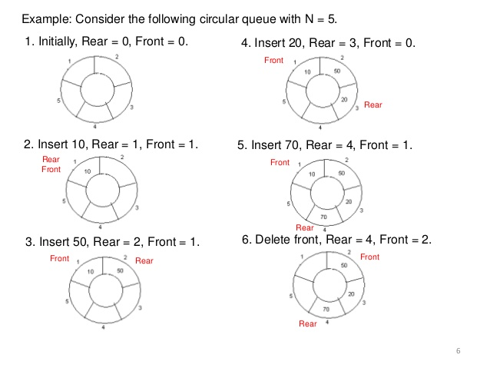

Slide 62
DEQUEUE() - DELETING A VALUE FROM THE CIRCULAR QUEUE
In a circular queue, deQueue() is a function used to delete an element from the circular queue. In a circular queue, the element is always deleted from front position. The deQueue() function doesn't take any value as parameter. We can use the following steps to delete an element from the circular queue...
Step 1: Check whether queue is EMPTY. (front == -1 && rear == -1)
Step 2: If it is EMPTY, then display "Queue is EMPTY!!! Deletion is not possible!!!" and terminate the function.
Step 3: If it is NOT EMPTY, then display queue[front] as deleted element and increment the front value by one (front ++). Then check whether front == SIZE, if it is TRUE, then set front = 0. Then check whether both front - 1 and rear are equal (front -1 == rear), if it TRUE, then set both front and rear to '-1' (front = rear = -1).

Slide 63
DISPLAY() - DISPLAYS THE ELEMENTS OF A CIRCULAR QUEUE
We can use the following steps to display the elements of a circular queue...
Step 1: Check whether queue is EMPTY. (front == -1)
Step 2: If it is EMPTY, then display "Queue is EMPTY!!!" and terminate the function.
Step 3: If it is NOT EMPTY, then define an integer variable 'i' and set 'i = front'.
Step 4: Check whether 'front <= rear', if it is TRUE, then display 'queue[i]' value and increment 'i' value by one (i++). Repeat the same until 'i <= rear' becomes FALSE.
Step 5: If 'front <= rear' is FALSE, then display 'queue[i]' value and increment 'i' value by one (i++). Repeat the same until'i <= SIZE - 1' becomes FALSE.
Step 6: Set i to 0.
Step 7: Again display 'cQueue[i]' value and increment i value by one (i++). Repeat the same until 'i <= rear' becomes FALSE.

Slide 64
End of Session – 7
Thank You…

Slide 65
Queues

Slide 66
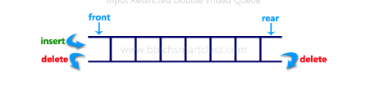
Double Ended Queue (Dequeue)
Double Ended Queue is also a Queue data structure in which the insertion and deletion operations are performed at both the ends (front and rear). That means, we can insert at both front and rear positions and can delete from both front and rear positions.

Slide 67
Dequeues are two types
Input restricted dequeue
Output restricted dequeue

Slide 68
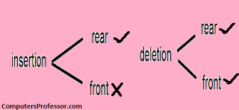
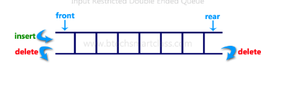
Input restricted dequeue
In Input restricted dequeue we restrict insertion.
In Input restricted dequeue deletions can takes place both ends front as well as rear.
Insertions can take place only one end called rear.

Slide 69
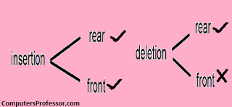
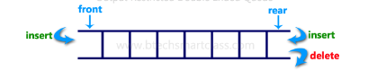
Output restricted dequeue
In Output restricted dequeue we restrict deletion.
In Output restricted dequeue insertions can takes place both place front as well as rear.
In Output restricted dequeue deletion can takes place at only one end called front.

Slide 70
void Queue :: enqueue(int x)
{
if( rear = SIZE-1)
{
cout << "Queue is full";
}
else
{
a[++rear] = x;
}
}
int queue :: dequeue()
{
return a[++front]; //following approach [B], explained above
}
/* Below program is written in C++ language */
#define SIZE 100
class Queue
{
int a[100];
int rear; //same as tail
int front; //same as head
public:
Queue()
{
rear = front = -1;
}
void enqueue(int x); //declaring enqueue, dequeue and display functions
int dequeue();
void display();
}

Slide 71
void queue :: display()
{
int i;
for( i = front; i <= rear; i++)
{
cout << a[i];
}
}

Slide 72
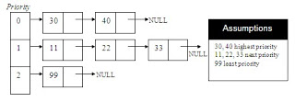
PRIORITY QUEUE:
A priority queue is a queue that contains items that have some preset priority. When an element has to be removed from a priority queue, the item with the highest priority is removed first

Slide 73
Priority queue contains data items which have some preset priority. While removing an element from a priority queue, the data item with the highest priority is removed first.
In a priority queue, insertion is performed in the order of arrival and deletion is performed based on the priority.

Slide 74
Priority queue is a linear data structure.
It is having a list of items in which each item has associated priority.
It works on a principle add an element to the queue with an associated priority and remove the element from the queue that has the highest priority.
In general different items may have different priorities.
In this queue highest or the lowest priority item are inserted in random order.
It is possible to delete an element from a priority queue in order of their priorities starting with the highest priority.

Slide 75
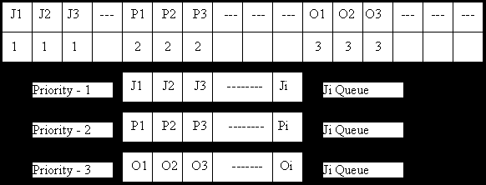

Slide 76
Normal queue data structure
In normal queue data structure, insertion is performed at the end of the queue and deletion is performed based on the FIFO principle. This queue implementation may not be suitable for all situations.
Consider a networking application where server has to respond for requests from multiple clients using queue data structure.
Assume four requests arrived to the queue in the order of R1 requires 20 units of time, R2 requires 2 units of time, R3 requires 10 units of time and R4 requires 5 units of time.
Queue is as follows...

Slide 77
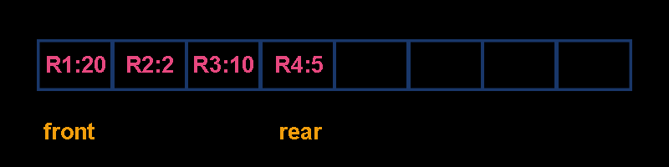
Now, check waiting time for each request to be complete.
R1 : 20 units of time
R2 : 22 units of time (R2 must wait till R1 complete - 20 units and R2 itself requeres 2 units. Total 22 units)
R3 : 32 units of time (R3 must wait till R2 complete - 22 units and R3 itself requeres 10 units. Total 32 units)
R4 : 37 units of time (R4 must wait till R3 complete - 35 units and R4 itself requeres 5 units. Total 37 units)

Slide 78
Priority queue is a variant of queue data structure in which insertion is performed in the order of arrival and deletion is performed based on the priority.
There are two types of priority queues they are as follows...
Max Priority Queue
Min Priority Queue

Slide 79
1. Max Priority Queue
In max priority queue, elements are inserted in the order in which they arrive the queue and always maximum value is removed first from the queue.
For example assume that we insert in order 8, 3, 2, 5 and they are removed in the order 8, 5, 3, 2.

Slide 80
The following are the operations performed in a Max priority queue...
isEmpty() - Check whether queue is Empty.
insert() - Inserts a new value into the queue.
findMax() - Find maximum value in the queue.
remove() - Delete maximum value from the queue.

Slide 81
Max Priority Queue Representations
There are 6 representations of max priority queue.
Using an Unordered Array (Dynamic Array)
Using an Unordered Array (Dynamic Array) with the index of the maximum value
Using an Array (Dynamic Array) in Decreasing Order
Using an Array (Dynamic Array) in Increasing Order
Using Linked List in Increasing Order
Using anUnordered Linked List with reference to node with the maximum value

Slide 82

Using Unordered Linked List with reference to node with the maximum value
In this representation, we use a single linked list to represent max priority queue. Always we maitain a reference (maxValue) to the node with maximum value. In this representation elements are inserted according to their arrival and node with maximum value is deleted first from max priority queue.
For example, assume that elements are inserted in the order of 2, 8, 3 and 5. And they are removed in the order 8, 5, 3 and 2.

Slide 83
Now, let us analyse each operation according to this representation...
isEmpty() - If 'head == NULL' queue is Empty. This operation requires O(1) time complexity that means constant time.
insert() - New element is added at end the queue with O(1) and update maxValue reference with O(1). This operation requires O(1) time complexity.
findMax() - To find maximum element in the queue is very simple as maxValue is referenced to the node with maximum value in the queue. This operation requires O(1) time complexity.
remove() - To remove an element from the queue is deleting the node which referenced by maxValue which requires O(1) and update maxValue reference to new node with maximum value in the queue which requires O(n) time complexity. This operation requires O(n) time complexity.

Slide 84
2. Min Priority Queue Representations
Min Priority Queue is similar to max priority queue except removing maximum element first, we remove minimum element first in min priority queue.
The following operations are performed in Min Priority Queue...
isEmpty() - Check whether queue is Empty.
insert() - Inserts a new value into the queue.
findMin() - Find minimum value in the queue.
remove() - Delete minimum value from the queue.

Slide 85
Example: Program for Priority Queue
#include <stdio.h> #include <stdlib.h> #define MAX 5 void insert_by_priority(int); void delete_by_priority(int); void create(); void check(int); void display_pqueue(); int pri_que[MAX]; int front, rear;
void main() { int n, ch; printf("\n1 Insert"); printf("\n2 Delete"); printf("\n3 Display"); printf("\n4 Exit"); create(); while (1) { printf("\nEnter your choice : "); scanf("%d", &ch); switch (ch) {

Slide 86
case 1: printf("\nInsert Element : "); scanf("%d",&n); insert_by_priority(n); break;
case 2: printf("\nEnter Element to Delete : "); scanf("%d",&n); delete_by_priority(n); break;
case 3: display_pqueue(); break; case 4: exit(0); default: printf("\n Invalid Choice"); } } }

Slide 87
void create() //Create Function { front = rear = -1; } void insert_by_priority(int data) //Insert Function { if (rear >= MAX - 1) { printf("\nQueue is Overflow"); return; }
if ((front == -1) && (rear == -1)) { front++; rear++; pri_que[rear] = data; return; } else check(data); rear++; }

Slide 88
void check(int data) //Check Function - to check priority and place element { int i,j; for (i = 0; i <= rear; i++) { if (data >= pri_que[i]) { for (j = rear + 1; j > i; j--) { pri_que[j] = pri_que[j - 1]; } pri_que[i] = data; return; } }
pri_que[i] = data; } void delete_by_priority(int data) //Delete Function { int i; if ((front==-1) && (rear==-1)) { printf("\nQueue is empty no elements to delete"); return; }

Slide 89
printf("\n %d not found in queue to delete", data); } void display_pqueue() //Display Function { if ((front == -1) && (rear == -1)) { printf("\nQueue is empty"); return; } for (; front <= rear; front++) { printf(" %d ", pri_que[front]); }
front = 0; }
for (i = 0; i <= rear; i++) { if (data == pri_que[i]) { for (; i < rear; i++) { pri_que[i] = pri_que[i + 1]; } pri_que[i] = -99; rear--; if (rear == -1) front = -1; return; } }

Slide 90
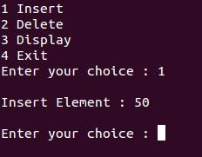

Output: 1. Insert
2. Display

Slide 91
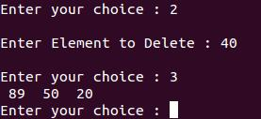
3. Delete

Slide 92
End of Session – 8
Thank You…

